Slide 1


SMART INDIA HACKATHON 2025
TITLE PAGE
Problem Statement ID – 25031
Problem Statement Title- Crowdsourced Civic lssue Reporting and Resolution System
Theme- Clean & Green Technology
PS Category- Software
Team ID-
Team Name – Runtime Terror

Slide 2
IDEA TITLE
Runtime Terror
Proposed Solution
Citizens will be able to click/upload photos, describe or use audio, enter location to submit a grievance.
Citizens can upvote a shikayat registered by other, indirectly pressurizing the authorities to solve it.
Even in when citizen is offline he will be able to queue the request, which will be submitted when he is online.

Slide 3
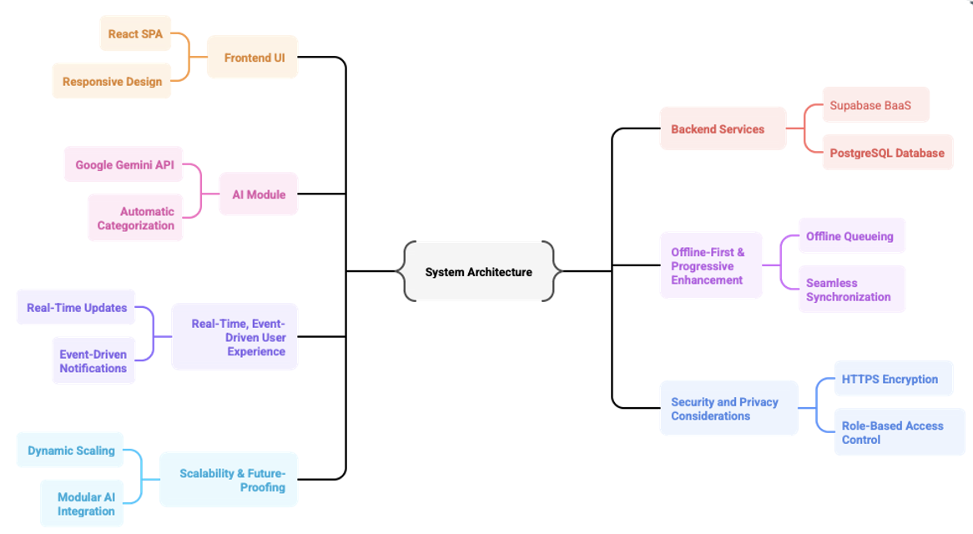
TECHNICAL APPROACH
Your Team Name
Runtime Terror

Slide 4
FEASIBILITY AND VIABILITY
Your Team Name
Runtime Terror
Feasibility, Challenges & Mitigation
Feasibility: Mobile app with AI, offline sync, multilingual UI, and cloud backend is practical and scalable.
->Challenges:
User adoption barriers, data privacy concerns, staff resistance, AI errors.
Mitigation: Offline queue, simple UI, training & awareness, encryption & compliance, human-in-loop AI review.

Slide 5
IMPACT AND BENEFITS
Your Team Name
Runtime Terror
Impact & Benefits
Citizens: Fast, transparent reporting with real-time updates
Government: Enhanced service delivery, efficient workflows, data-driven insights
City: Cleaner, safer, more responsive infrastructure
Social: Increases citizen engagement & trust
Economic: Cuts repeat repair costs via timely fixes
Environmental: Enables faster waste management for cleaner cities

Slide 6
RESEARCH AND REFERENCES
Your Team Name
Runtime Terror
Mumbai Civic Grievance Tracking: challenges & solutions in urban public reporting [citizenmatters.in]
Smartphone Civic Reporting Apps boost efficiency and citizen engagement [irjmets.com]
AI & NLP improve complaint classification and government responsiveness [ssrn.com][oidp.net]
Indic language growth & multilingual voice AI adoption drive rural digital inclusion [storyboard18.com][gnani.ai]
Gov responsiveness linked to citizen trust & participation [opengovpartnership.org][afrobarometer.org]

